Slide 1
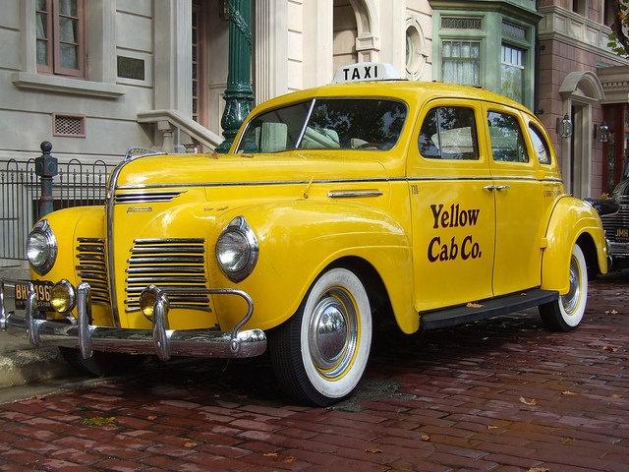
NEW YORK TAXIS
INSIGHTS AND ANALYSIS
Notes:
Welcome, my project is on New York Yellow taxis.

Slide 2
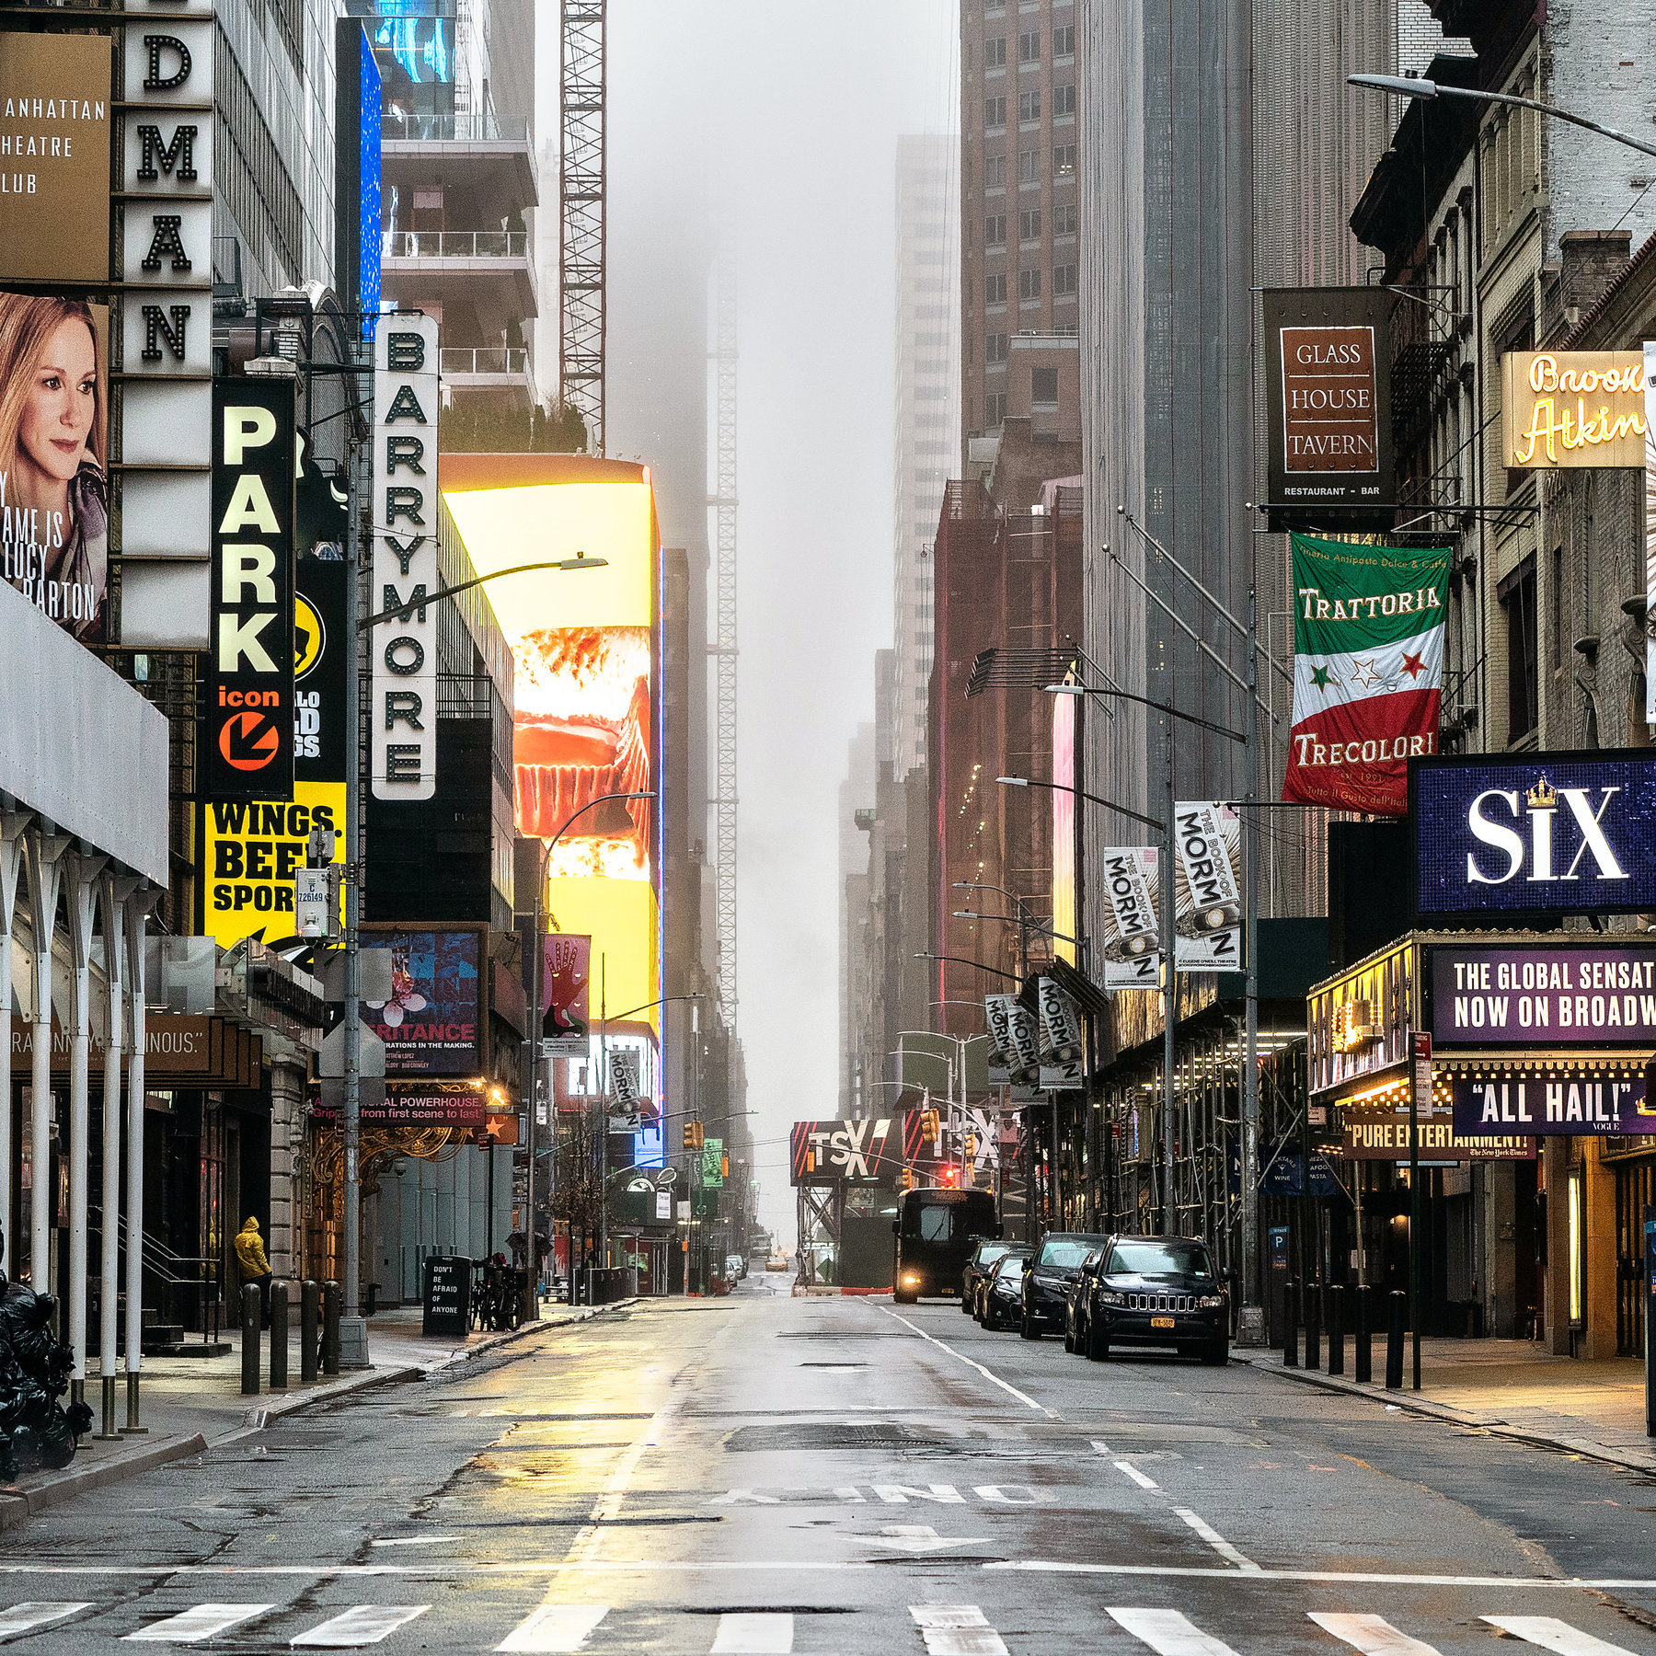
New York taxis examining the data to reduce costs and identifying improvement areas for service….
Notes:
We were hired by NY yellow cabs to conduct analyses around their business and suggest any improvements

Slide 3
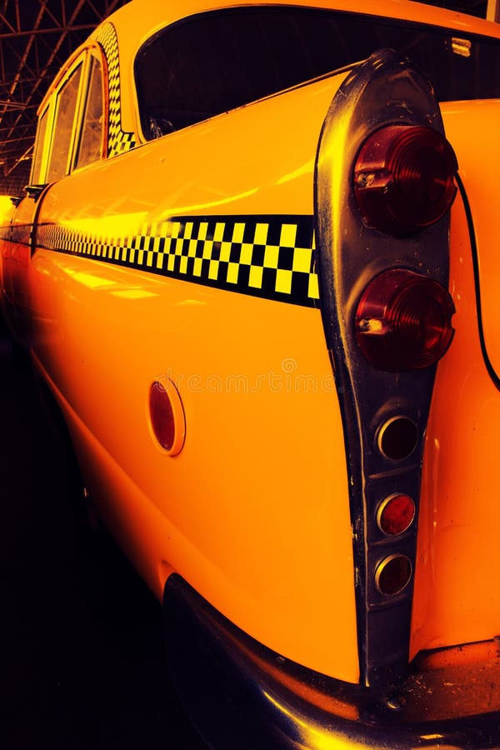
Areas of interest
Tip amounts and predictions
Predicting the number of taxi rides per hour and day of the week
Peak periods
Anomaly Detection: Can we identify anomalous trips that might suggest fraudulent activity

Slide 4

Datasets, EDA and cleaning
Source of data:
https://www.nyc.gov/site/tlc/about/tlc-trip-record-data.page
https://data.cityofnewyork.us/Transportation/NYC-Taxi-Zones/d3c5-ddgc
Notes:
the raw concatenated DataFrame is very large, with over 400 million rows. To make the data more manageable, I decided to work with a random sample of 40,000 rows. Problems faced was trip duration so created a new column. Parquet files not compatible with excel. I also found geospatial data but unfortunately I found around 9 last night. I used some of my library of pre-defined functions to make cleaning and EDA more time efficient.

Slide 5
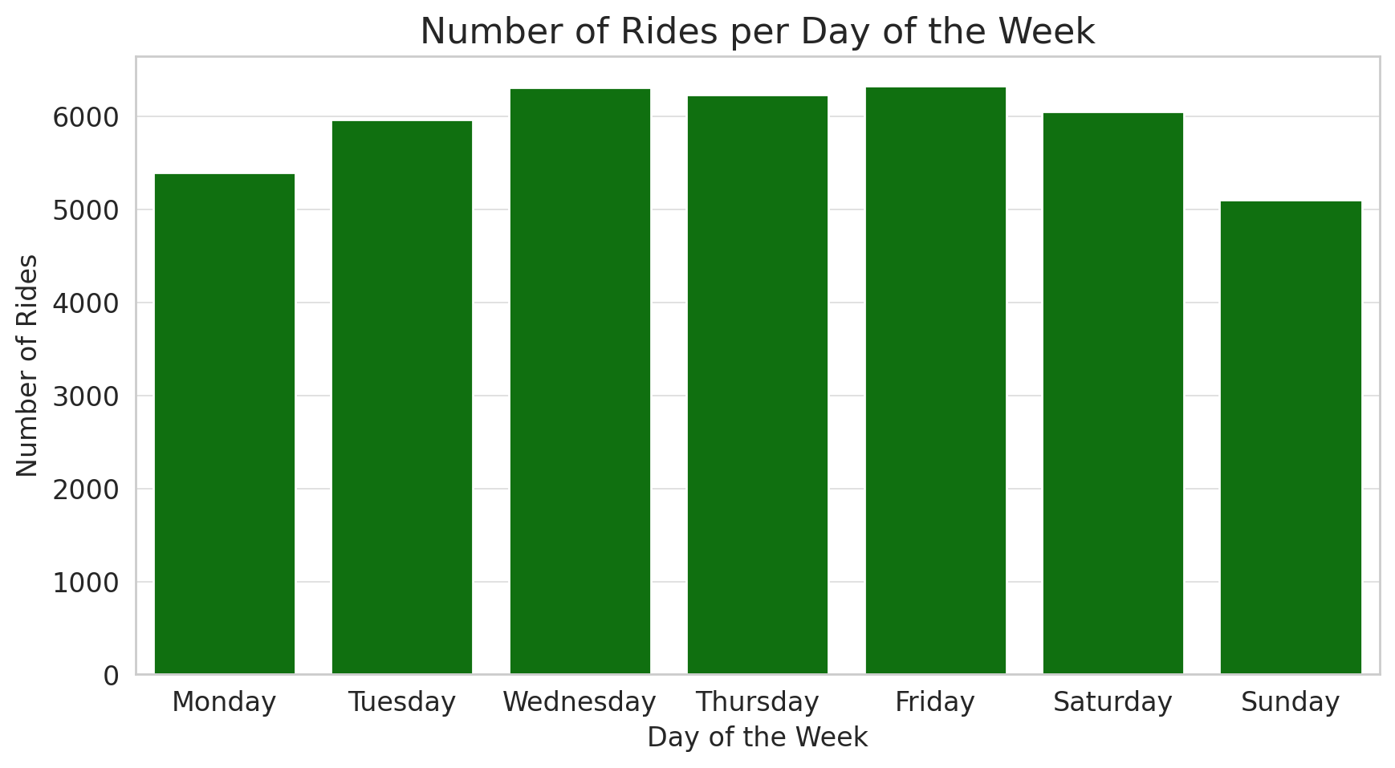
New York City PowerPoint
RMSE of 1.91 is 'fair' in the context of tips here. 0.53 r2 seems middling showing the the model accounts for 53% of the variance in the tip amountHow

Slide 6
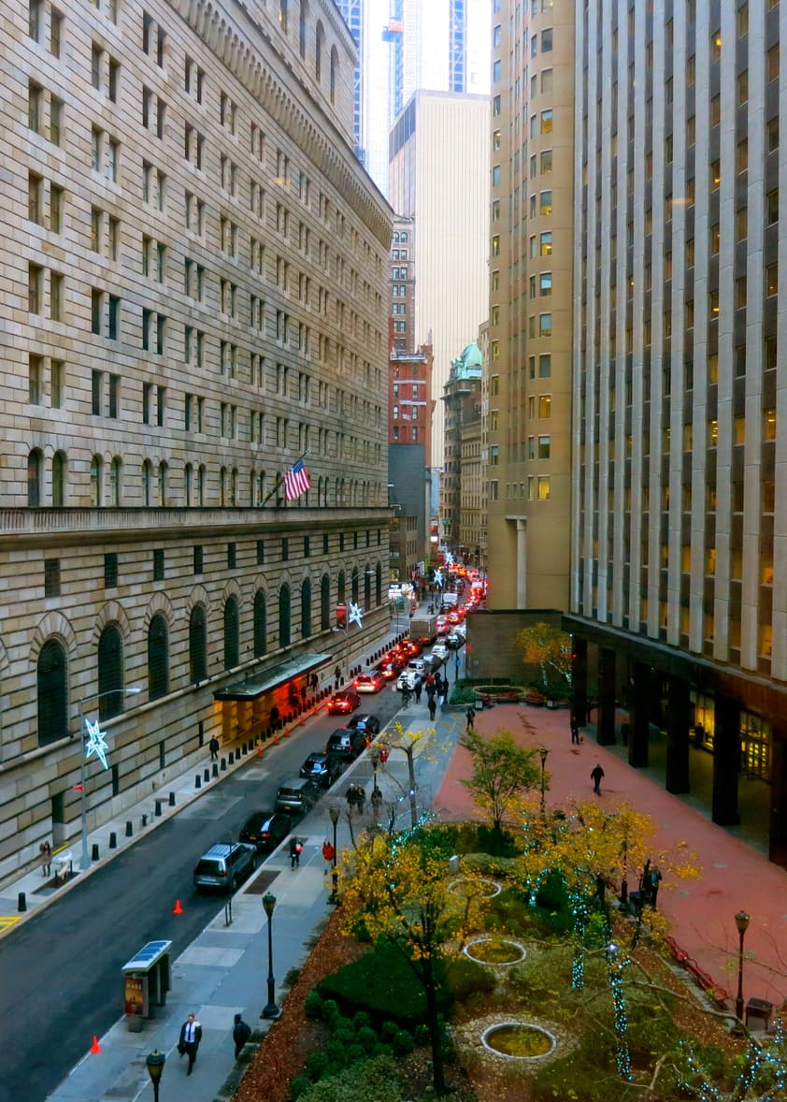
How well could we predict tip amounts?
Notes:
How well can we predict the tip amount for a taxi ride using a Linear Regression model based on the given features? passenger_count', 'trip_distance', 'fare_amount', 'tolls_amount', 'total_amount', 'trip_duration_secondsAs seen here many of the tips were outliers so I decided to use 3 STD inclusion rather than using 25/75

Slide 7
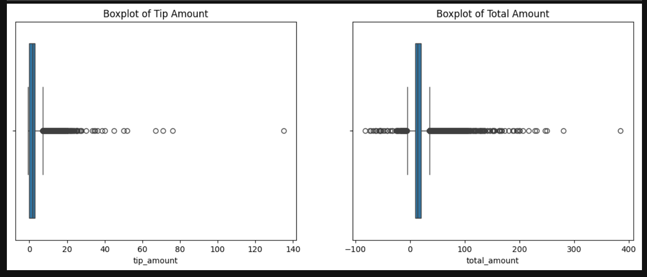
Notes:
How well can we predict the tip amount for a taxi ride using a Linear Regression model based on the given features? As seen here many of the tips were outliers so I decided to use 3 STD inclusion rather than using 25/75. One lucky driver had a tip of 400 dollars for a ride of a 10 minutes – Maybe a banker got his bonus that day since the pickup was on wall st.

Slide 8
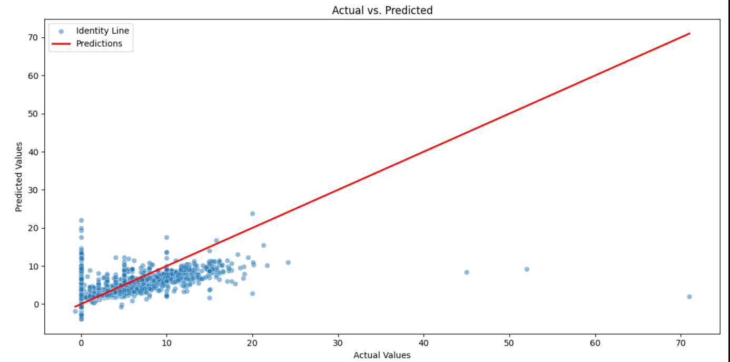
Notes:
RMSE of 1.91 is 'fair' in the context of tips here. 0.53 r2 seems middling showing the the model accounts for 53% of the variance in the tip amount

Slide 9
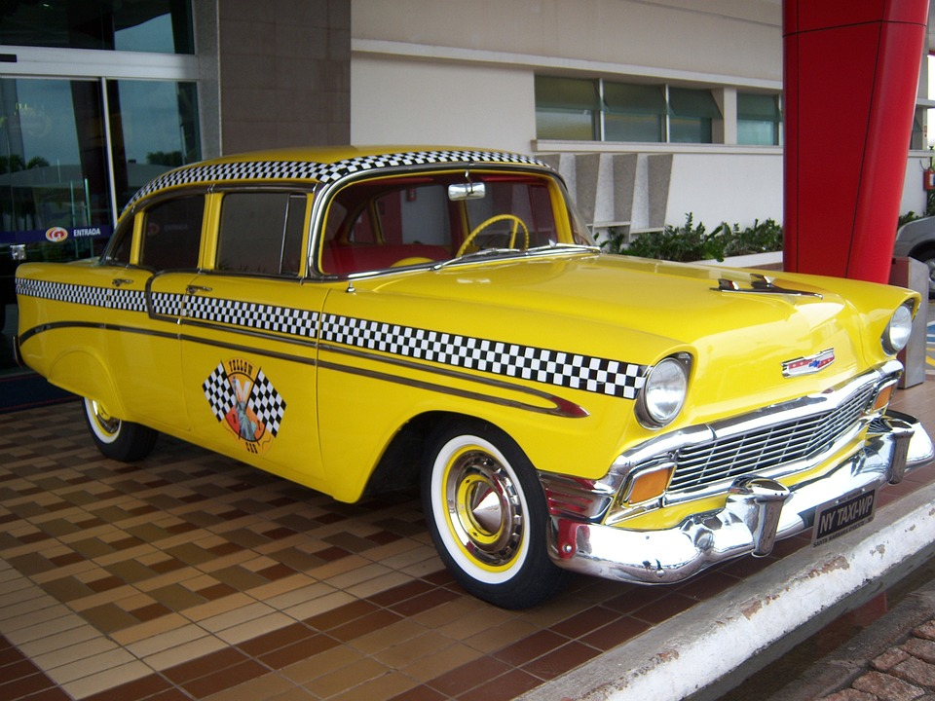

New York City PowerPoint
To examine feature importance I implemented
a random forest model
The Bronx Zoo

Slide 10
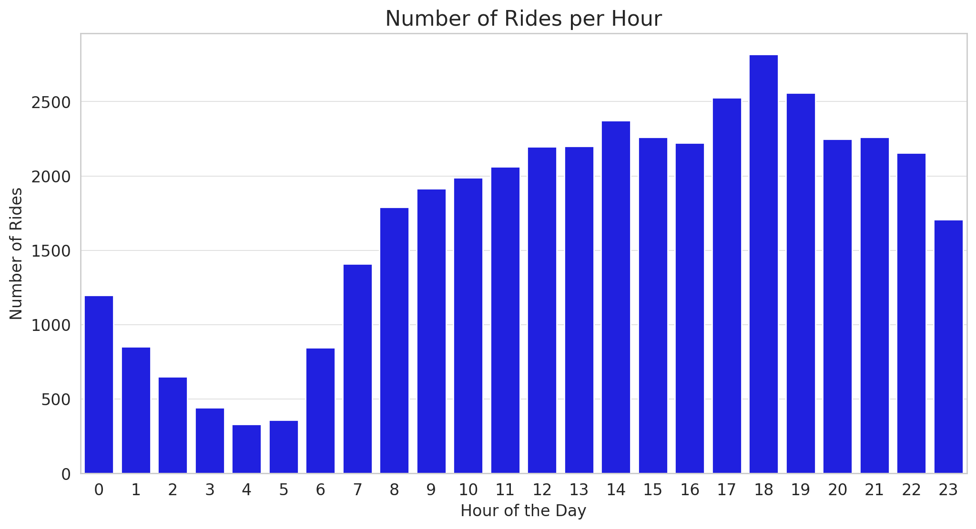
New York City PowerPoint
Greenwich Village
Known for its bohemian and artistic atmosphere, Greenwich Village is a neighborhood in Lower Manhattan. It is famous for its historic townhouses, cafes, jazz clubs, and its association with the Beat Generation and counterculture movements.
Notes:
First RMSE for my model with tries to predict the number of cars required at a given hour/day was 330 so far to big given the mean values for cars active was 1750 or so.
I improved this by adding more features and implementing cross validation and executing both grid and random search (there was barely any difference between the two)

Slide 11
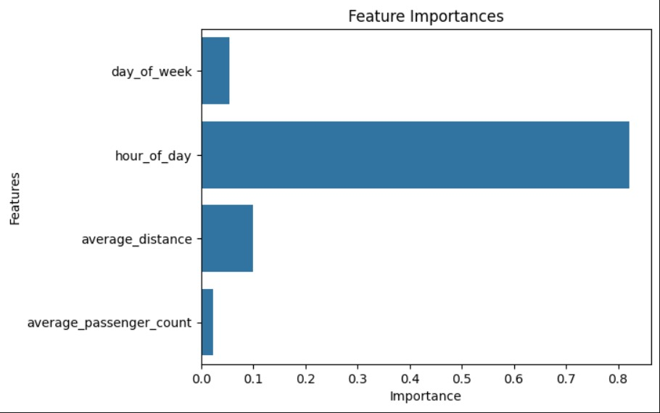
RMSE: 41.86
R^2 score 0.86
Icons
Notes:
Random forest new features derived from the time ofpickup_datetime column, such as the hour of the day, day of the week, week of the year, and a binary indicator of whether the day is a weekend. It also renames some columns for clarity.
'R^2 score: 0.86'
'Test set RMSE: 36

Slide 12
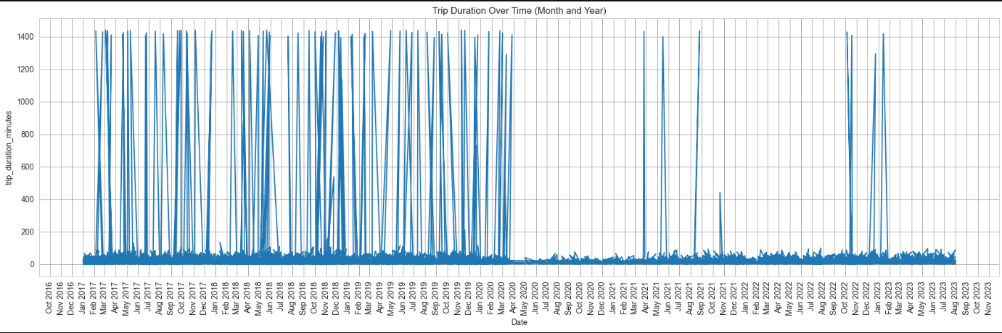


Slide 13
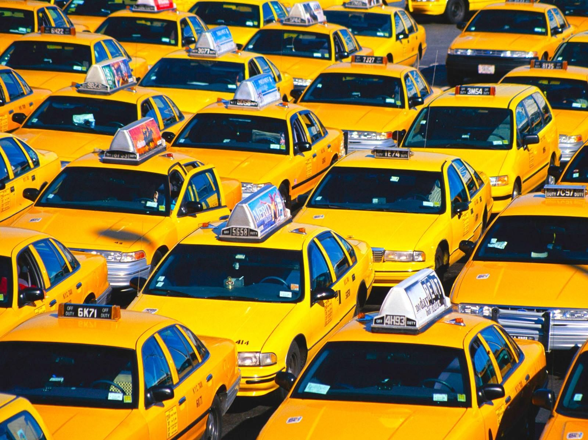
Could we find meaningful clusters within the taxi dataset that help us understand different patterns in the data and what were there characteristics?
Can we identify any patterns in payment disputes?
Notes:
(38905, 77805) after 1HE We will attempt to reduce features. Attemped with PCA but it wasn’t compatible with OneHotEncoded feats. Ss I used Singular Value Decompositionand used SVD to reduce number of features to 50

Slide 14
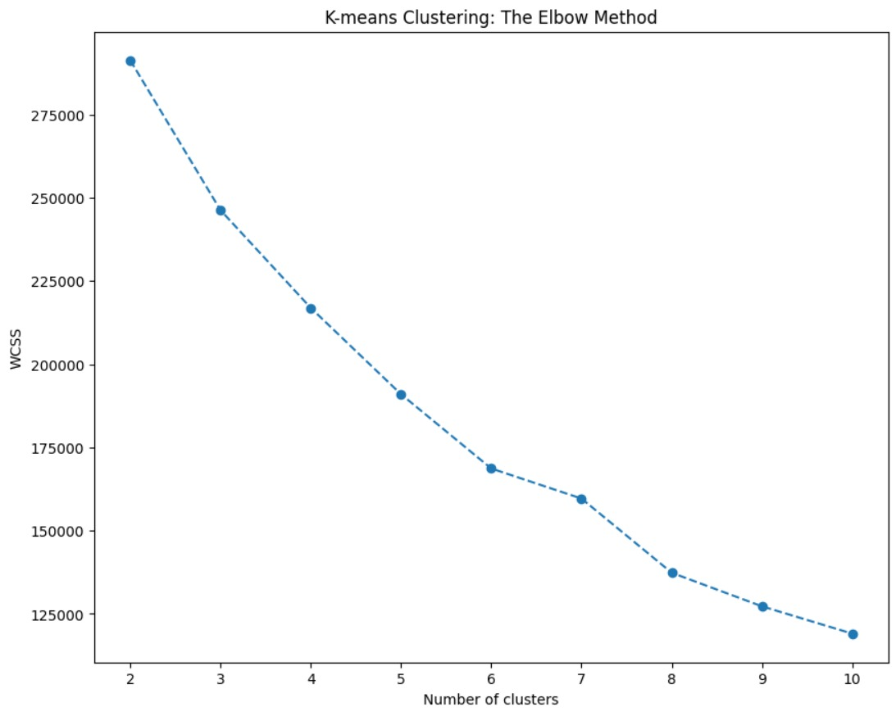
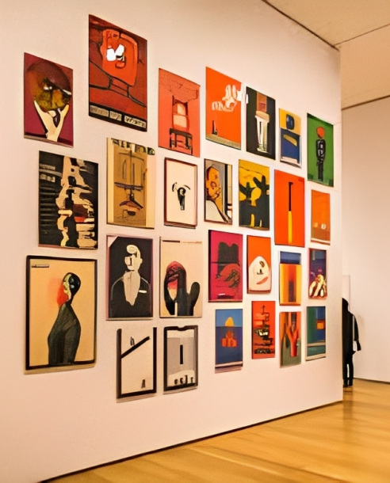
Notes:
(38905, 77805) after 1HE We will attempt to reduce features. Attemped with PCA but it wasn’t compatible with OneHotEncoded feats. Ss I used Singular Value Decompositionand used SVD to reduce number of features to 50

Slide 15
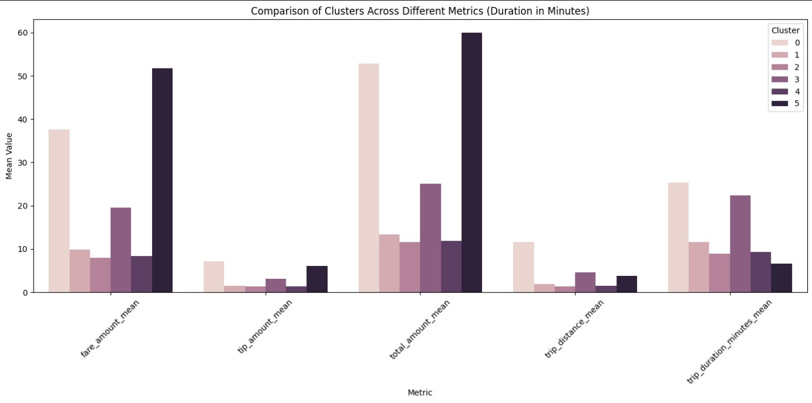
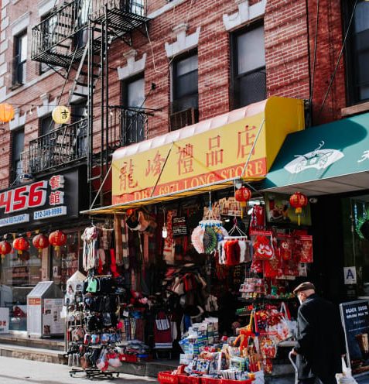
New York City PowerPoint
Chinatown
Located in Lower Manhattan, Chinatown is a vibrant neighborhood filled with colorful shops, markets, and authentic Asian cuisine. It offers a glimpse into Chinese culture and heritage in the heart of the city.
Notes:
luster 0: This cluster has higher average and median fare amounts and trip distances. The most common payment type is 1, which corresponds to credit card payments. This could be a cluster of longer, more expensive trips where passengers are less likely to use cash.
Cluster 1: This cluster has lower average and median fare amounts and trip distances, also with credit card as the most common payment type.
Cluster 2: This cluster stands out with a very high mean for fare_amount and total_amount, but a very low median for trip_distance. This suggests some very expensive trips that are not necessarily long, which could be a flag for potential disputes. Interestingly, the standard deviation for tip_amount is very high due to some large tips, which could be related to the negotiated fares or other special rate codes.
Cluster 3: This cluster is characterized by relatively short trips with moderate fare amounts.
Cluster 4: Similar to Cluster 3, this one has short trips and low fare amounts.
Cluster 5: This cluster has significantly longer trips both in terms of distance and duration, with high fare amounts.
Cluster 6: This is the only cluster where the most common payment type is 2, which corresponds to cash. This cluster has relatively short trips and very low tip amounts, which might indicate trips where disputes are more likely to occur since cash transactions are harder to trace and can lead to disagreements about the fare.
Clusters with higher variability in fare_amount, tip_amount, and total_amount could be more prone to fare disputes, especially if combined with certain payment types (like cash) that are more likely to be disputed. Further investigation into these clusters might reveal more patterns related to disputes.

Slide 16
Clustering metrics
Silhouette Score: 0.213
Davies-Bouldin Index: 1.244
Calinski-Harabasz Index: 10076.54
Notes:
A score of 0.213 suggests that clusters are, on average, only moderately defined, which may indicate overlapping clusters or that the data is not very clusterable.
A value of 1.244 is relatively low, which suggests that the clusters are fairly well-separated and each cluster is distinct from its most similar counterpart.
The high value of 10076.54 indicates that the clusters are well-separated and cohesive, which is a sign of good clustering.

Slide 17
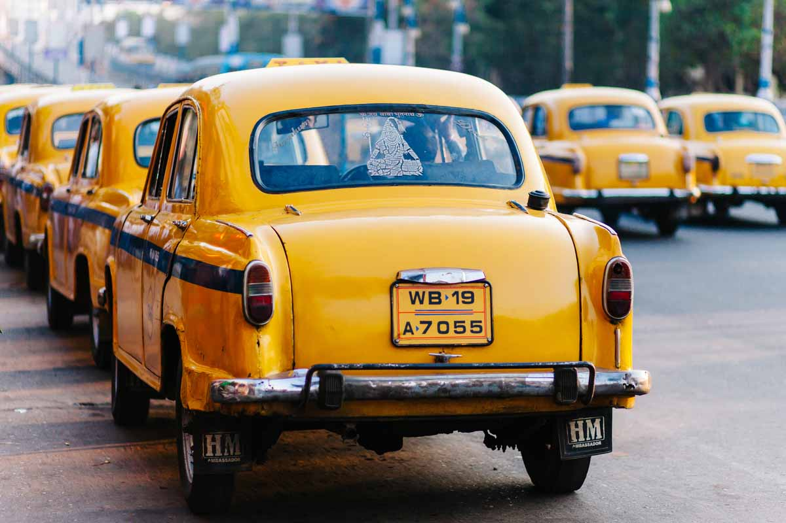
Future Ideas
Futures ideas/implementations: With more time we can add features and more interactive maps, weather data, and carbon footprint data as well as a cost analysis of switching to electric vehicles.

Slide 18
Fin!

